Slide 1
Biological Modeling of Neural Networks
Week 8 – parts 4-6 Noisy Output: Escape Rate and Soft Threshold
8.1 Variation of membrane potential
- white noise approximation
8.2 Autocorrelation of Poisson
8.3 Noisy integrate-and-fire
- superthreshold and subthreshold
8.4 Escape noise
- stochastic intensity
8.5 Renewal models
8.6 Comparison of noise models
Week 8 – Noisy output models:
Escape rate and soft threshold
Wulfram Gerstner
EPFL, Lausanne, Switzerland

Slide 2
Neuronal Dynamics – Review: Sources of Variability
- Intrinsic noise (ion channels)
Finite number of channels
Finite temperature
Na⁺
small contribution!
K⁺
Network noise (background activity)
Spike arrival from other neurons
Beyond control of experimentalist
Noise models?
big contribution!

Slide 3
Noise models
escape process,
stochastic intensity
stochastic spike arrival
(diffusive noise)
u(t)
t
escape rate
noisy integration
Now:
Escape noise!
Relation between the two models:
later

Slide 4
Neuronal Dynamics – 8.4 Escape noise
escape process
escape rate
u(t)
t
escape rate
Example: leaky integrate-and-fire model
u

Slide 5
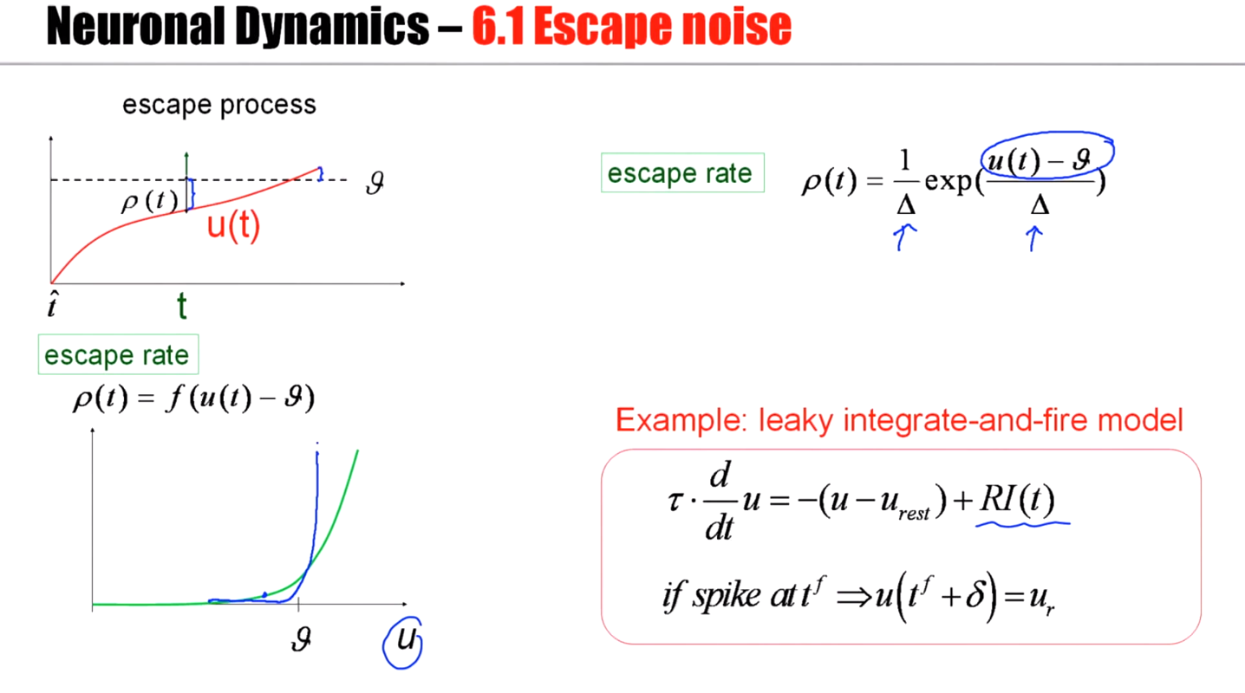

Slide 6
Neuronal Dynamics – 8.4 stochastic intensity
escape process
Escape rate = stochastic intensity
of point process
u(t)
t
escape rate
examples
u

Slide 7
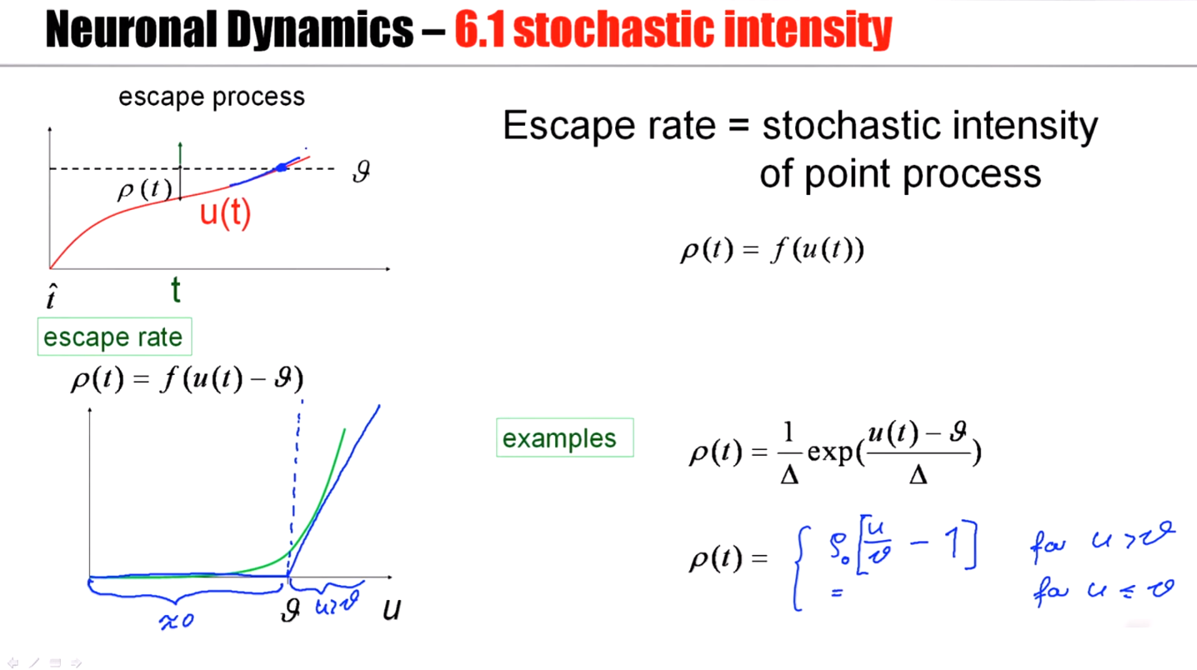

Slide 8
Neuronal Dynamics – 8.4 mean waiting time
escape rate
u(t)
t
u
1ms
I(t)
mean waiting time, after switch
t
Blackboard,
Math detour

Slide 9
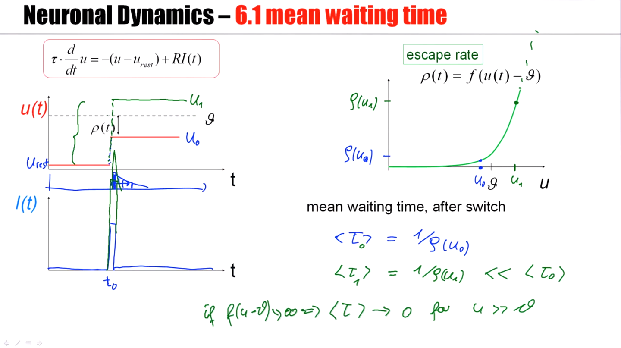
Notes:
This probability of finding a spike, a first spike, will decrease over time just because if the neuron has fired here in the first pin, you can no longer fire its first spike a little bit later.
And the mean waiting time would be the mean of this waiting time distribution. So the mean waiting time, for this exponential distribution will be just 1/ρ(u_0).

Slide 10
Neuronal Dynamics – 8.4 escape noise/stochastic intensity
Escape rate = stochastic intensity
of point process
u(t)
t

Slide 11
Neuronal Dynamics – Quiz 8.4
Escape rate/stochastic intensity in neuron models
[ ] The escape rate of a neuron model has units one over time
[ ] The stochastic intensity of a point process has units one over time
[ ] For large voltages, the escape rate of a neuron model always saturates
at some finite value
[ ] After a step in the membrane potential, the mean waiting time until a spike is fired is proportional to the escape rate
[ ] After a step in the membrane potential, the mean waiting time until a spike is fired is equal to the inverse of the escape rate
[ ] The stochastic intensity of a leaky integrate-and-fire model with reset only depends on the external input current but not on the time of the last reset
[ ] The stochastic intensity of a leaky integrate-and-fire model with reset depends on the external input current AND on the time of the last reset

Slide 12
Biological Modeling of Neural Networks
Week 8 – part 5 : Renewal model
8.1 Variation of membrane potential
- white noise approximation
8.2 Autocorrelation of Poisson
8.3 Noisy integrate-and-fire
- superthreshold and subthreshold
8.4 Escape noise
- stochastic intensity
8.5 Renewal models
Week 8 – Variability and Noise:
Autocorrelation
Wulfram Gerstner
EPFL, Lausanne, Switzerland

Slide 13
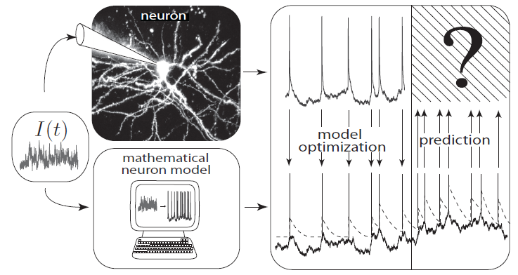
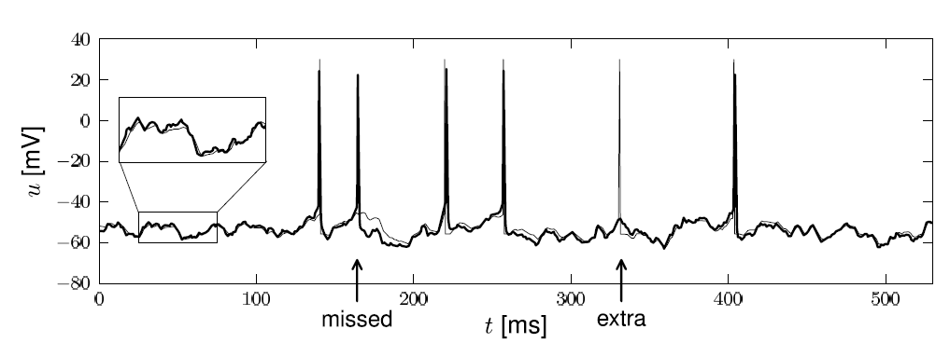
Neuronal Dynamics – 8.5. Interspike Intervals
t
deterministic part of input
noisy part of input/intrinsic noise
→ escape rate
Example:
nonlinear integrate-and-fire model
Example:
exponential stochastic intensity

Slide 14
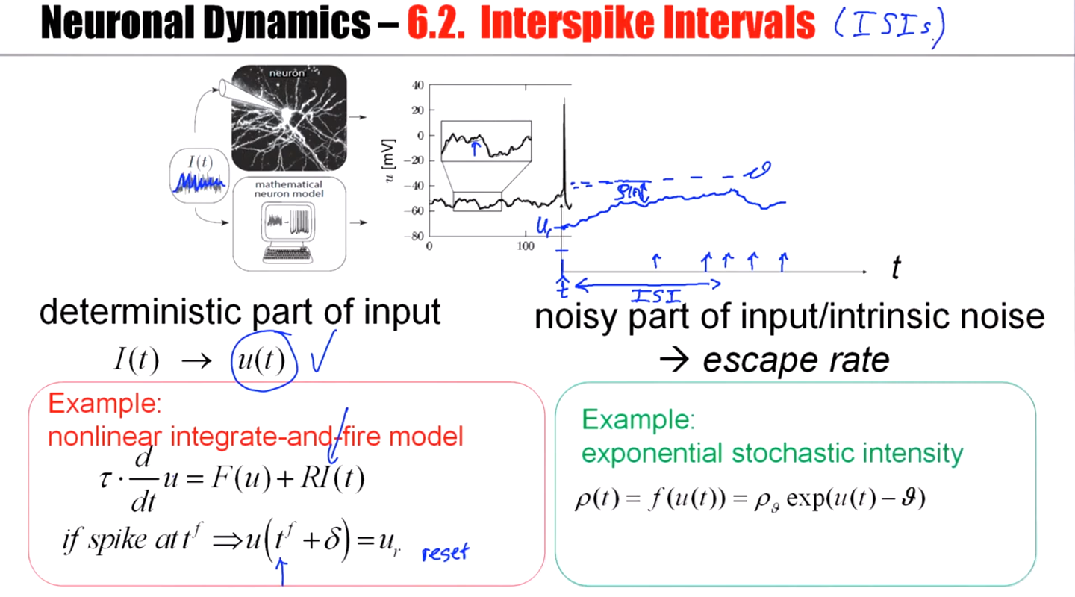

Slide 15
Neuronal Dynamics – 8.5. Interspike Interval distribution
escape process
escape rate
u(t)
Survivor function
t
t
t

Slide 16
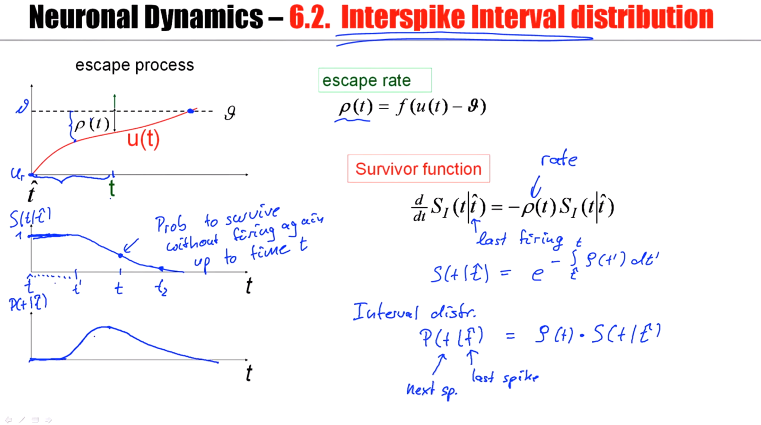
Notes:
The neuron has to survive from t-hat to t without firing again. But then it actually has to fire at time t.
对于ISI分布，前面应该没什么概率firing，所以很小；后面因为很大的概率已经firing了，所以也很小。

Slide 17
Neuronal Dynamics – 8.5. Interspike Intervals
escape process
Survivor function
Examples now
A
u(t)
t
escape rate
Interval distribution
escape
rate
Survivor function
u

Slide 18
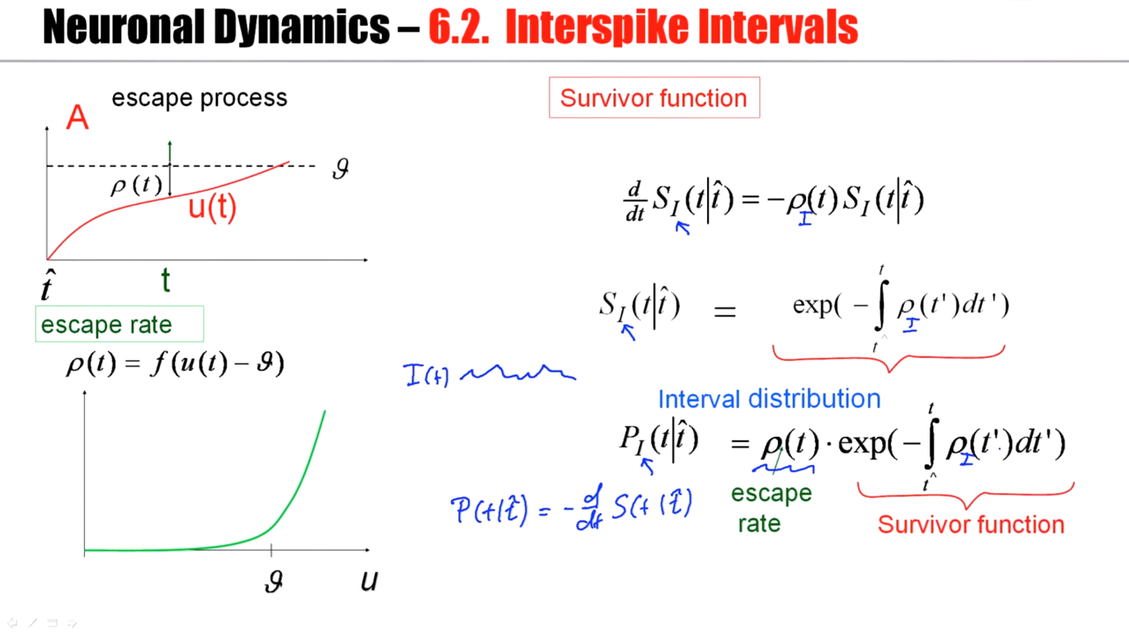
Notes:
In order to get to the interval distribution, I take the survivor function part, and then I multiply with the momentary escape rate.
We give some time-dependent, fluctuating, deterministic, known signal input. And in the presence of input, I can calculate the probability density that the next spike occurs at
t, given I know the last firing time was at t-hat.

Slide 19
Neuronal Dynamics – 8.5. Renewal theory
Example: I&F with reset, constant input
escape rate
Survivor function
1
Interval distribution

Slide 20
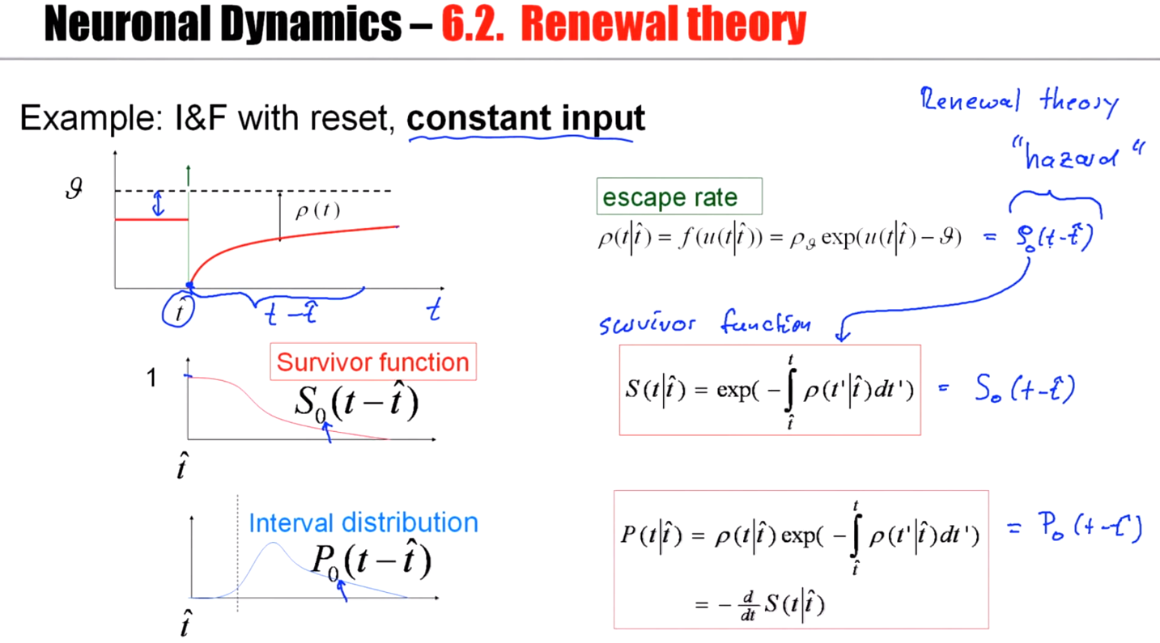
Notes:
因为input是常数，所以一切函数都是时间（到达峰值的时间）的函数
This situation of constant input where the escape rate just depends on t minus t-hat is called renewal theory. For the case of renewal theory, the stochastic intensity is also called
the hazard.

Slide 21
Neuronal Dynamics – 8.5. Time-dependent Renewal theory
Example: I&F with reset, time-dependent input,
escape rate
Survivor function
1
Interval distribution
Notes:
In this case, I have an input dependent survivor function.

Slide 22
Neuronal Dynamics – 8.5. Firing probability in discrete time
Probability to survive 1 time step
Probability to fire in 1 time step

Slide 23
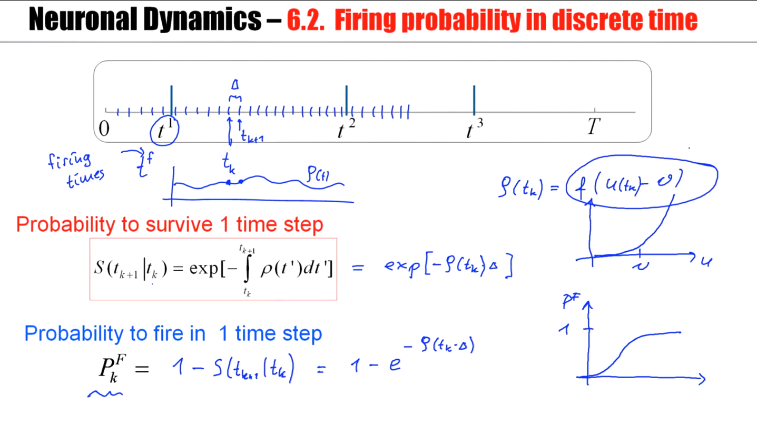

Slide 24
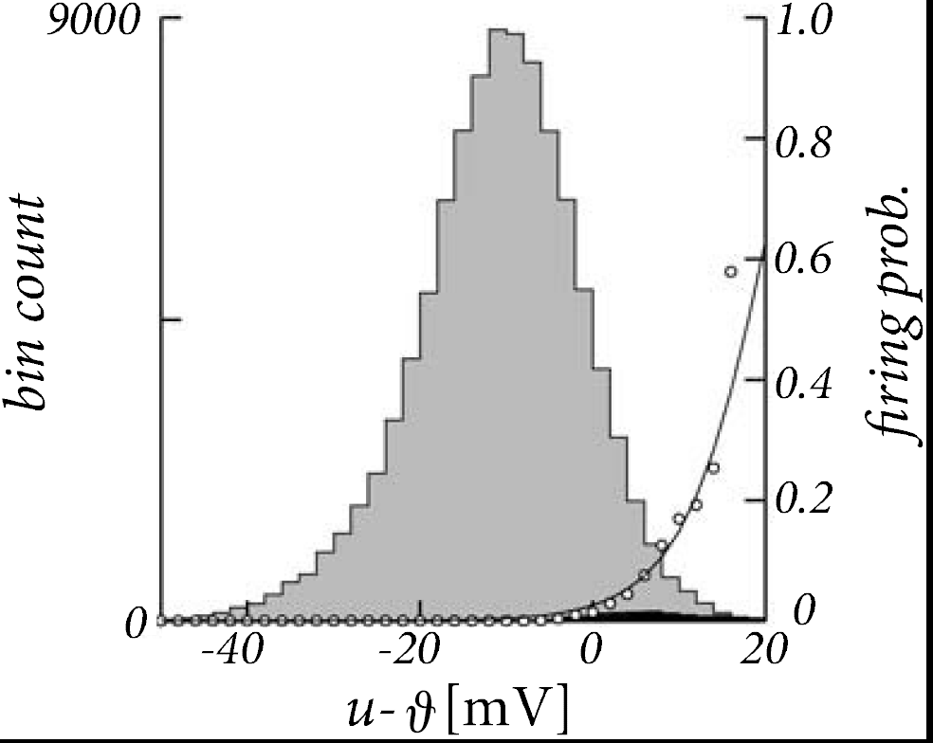
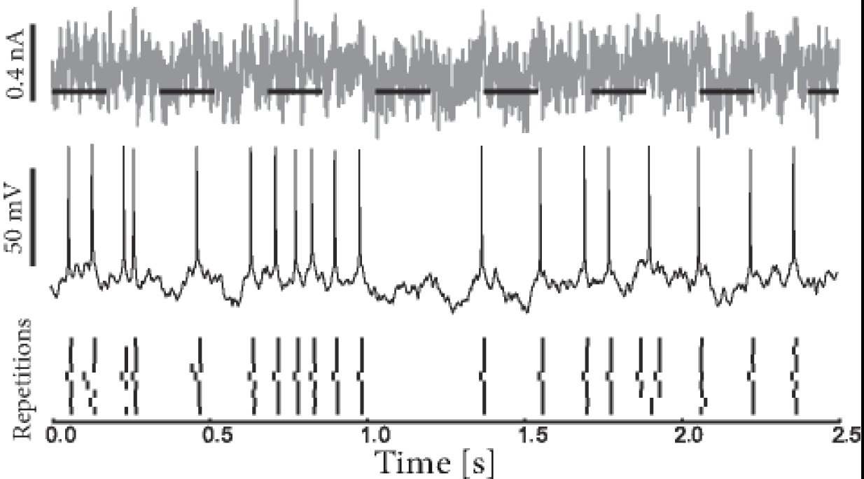
Neuronal Dynamics – 8.5. Escape noise - experiments
Jolivet et al. ,
J. Comput. Neurosc.
2006
escape rate

Slide 25
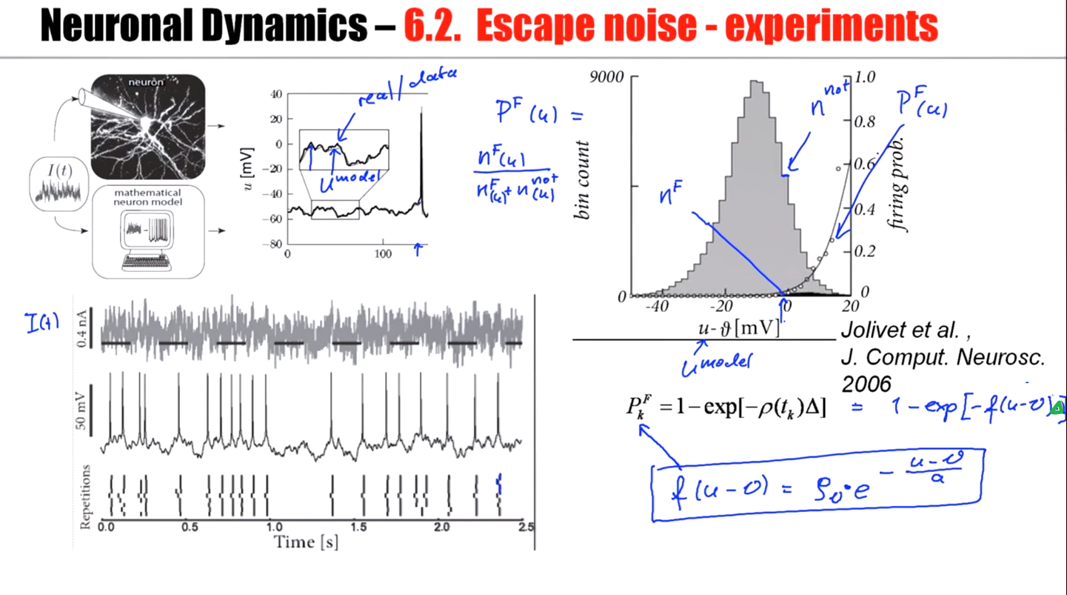

Slide 26
Neuronal Dynamics – 8.5. Renewal process, firing probability
Escape noise = stochastic intensity
Renewal theory
- hazard function
- survivor function
- interval distribution
time-dependent renewal theory
discrete-time firing probability
Link to experiments
→ basis for modern methods of
neuron model fitting

Slide 27
Neuronal Dynamics – Homework assignement
neuron with relative refractoriness, constant input
escape rate
Survivor function
1
Interval distribution

Slide 28
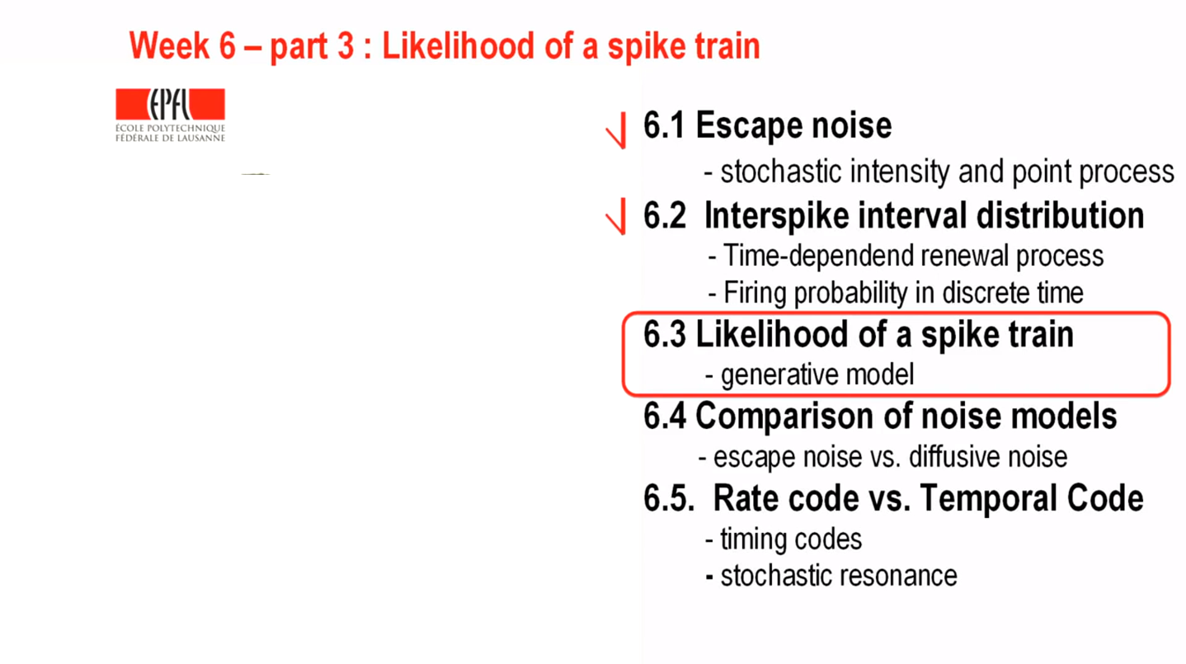

Slide 29
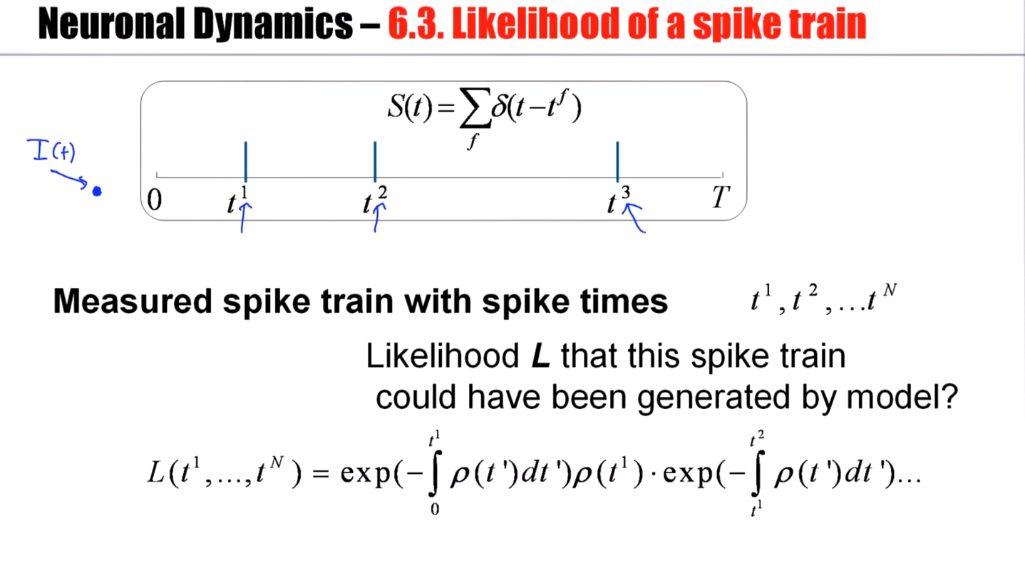

Slide 30
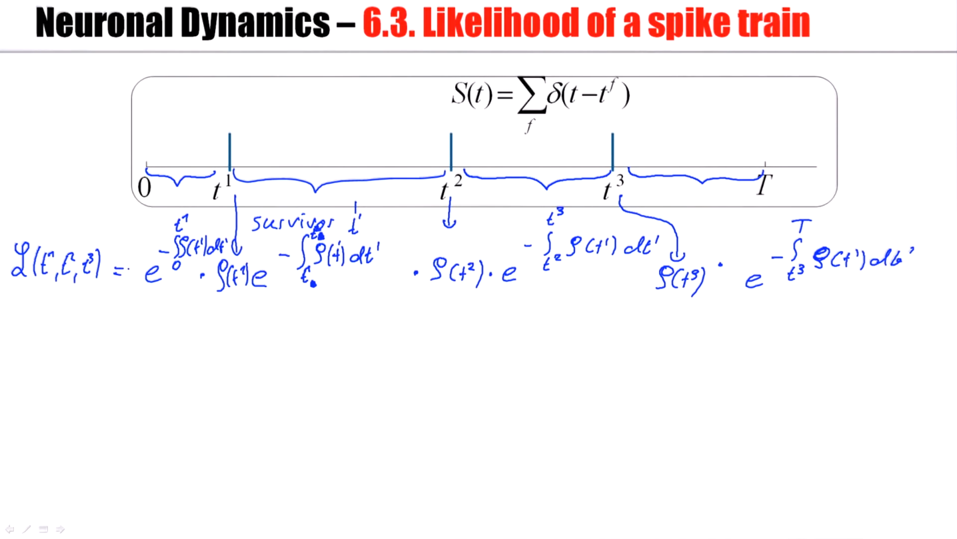

Slide 31
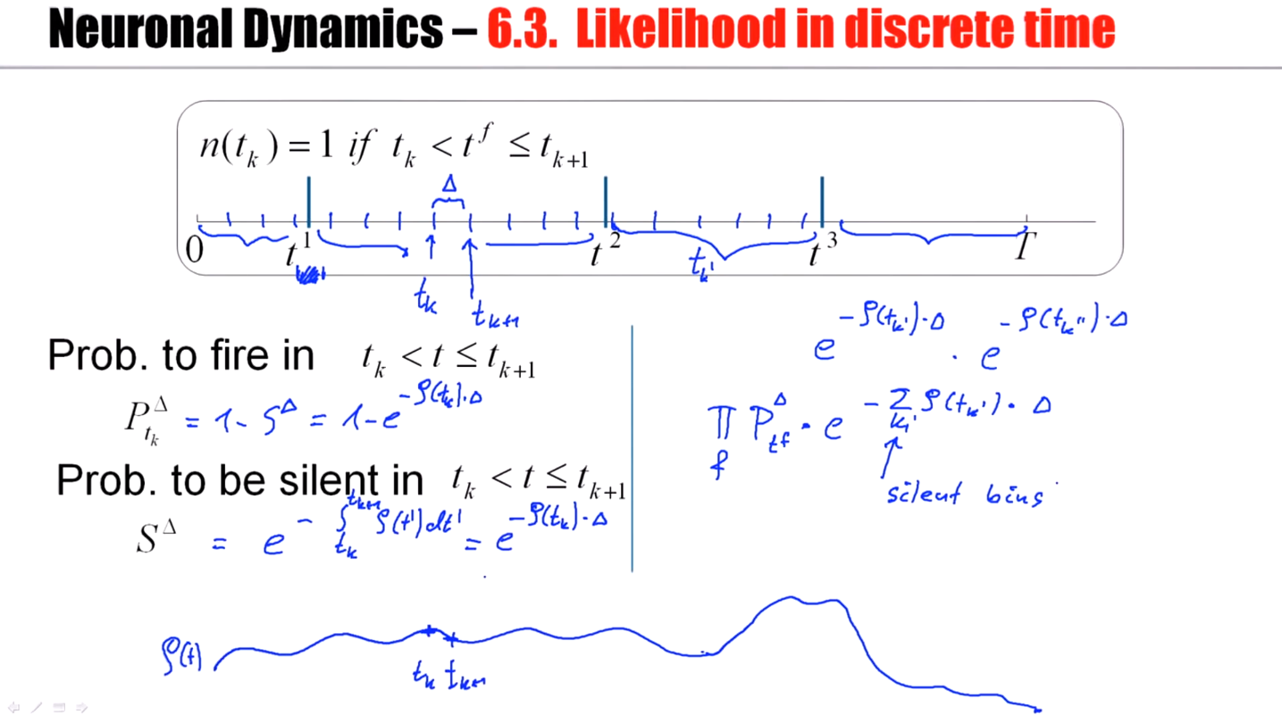
Notes:
What happens if I make this bin size, delta T, smaller and smaller?

Slide 32
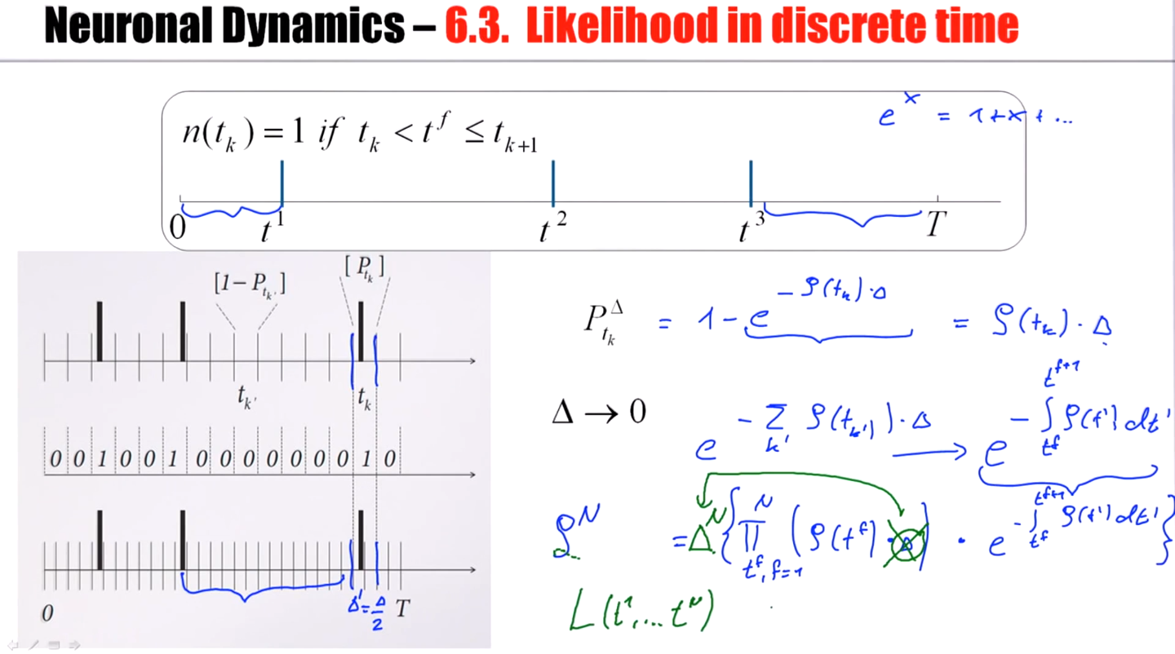

Slide 33
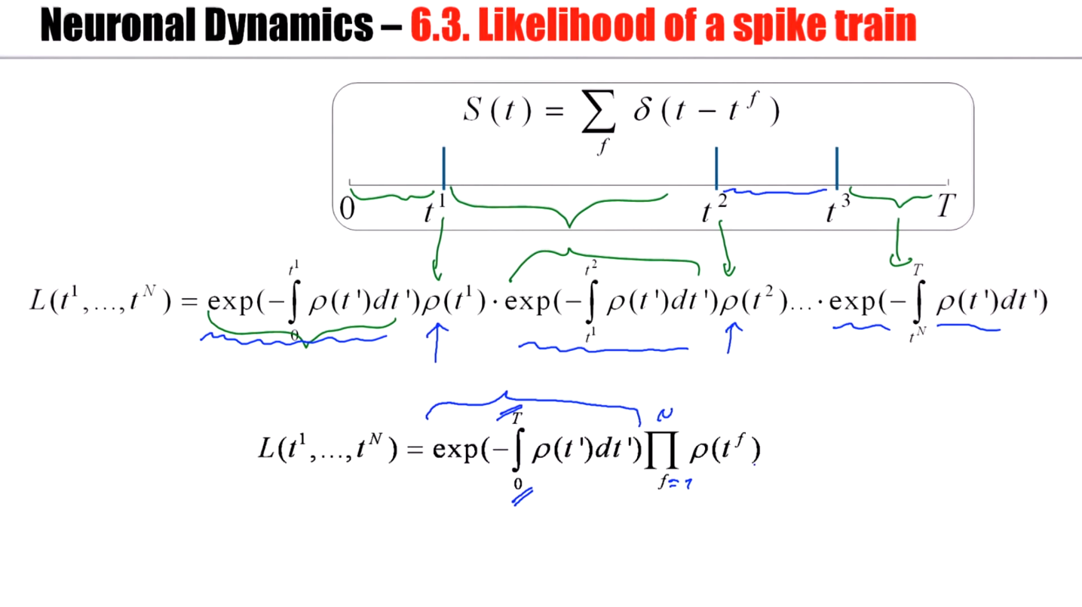

Slide 34
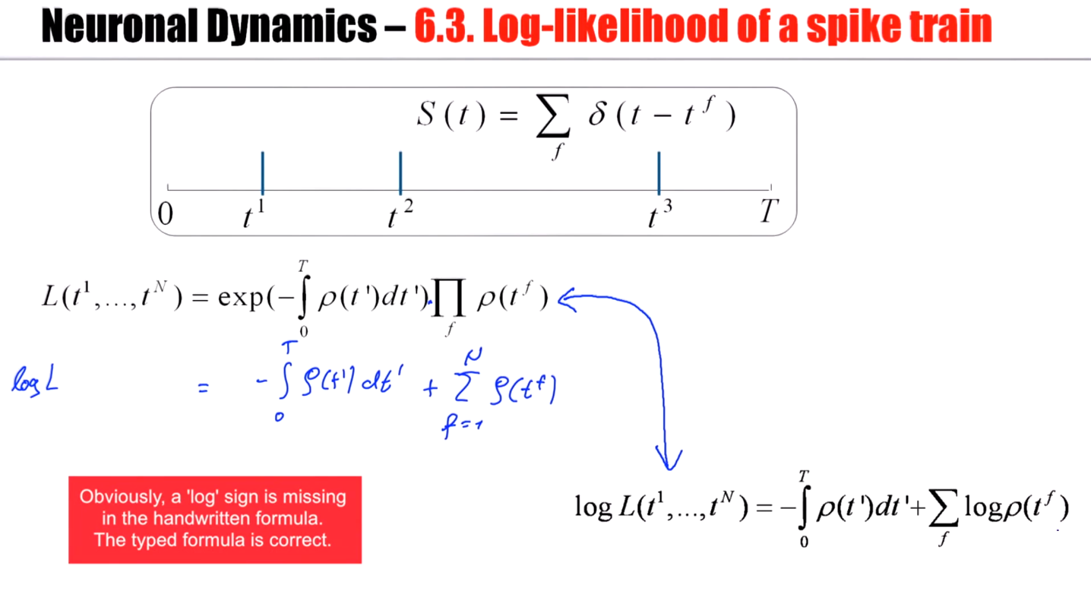

Slide 35
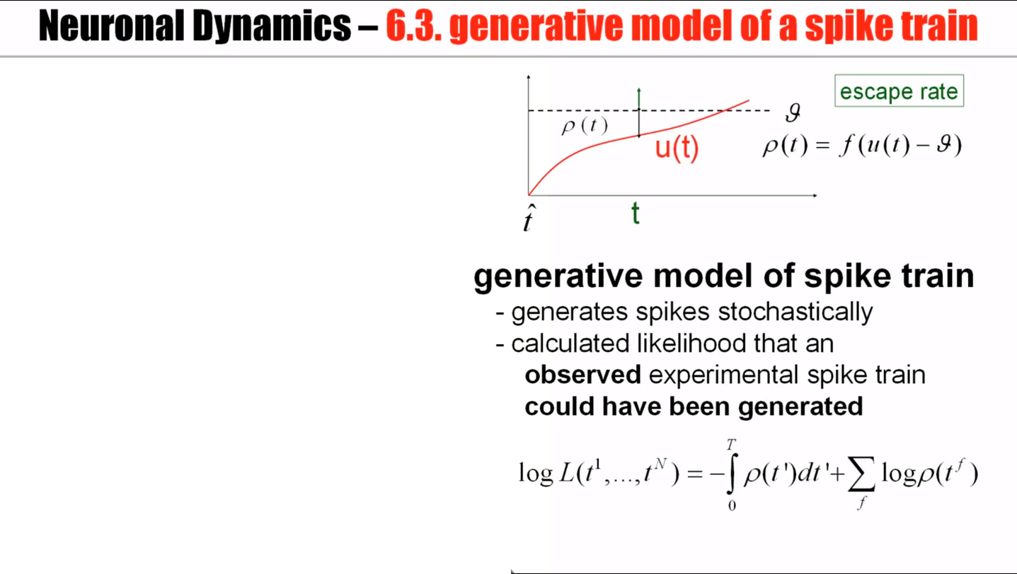

Slide 36
Biological Modeling of Neural Networks
Week 8 – part 6 : Comparison of noise models
8.1 Variation of membrane potential
- white noise approximation
8.2 Autocorrelation of Poisson
8.3 Noisy integrate-and-fire
- superthreshold and subthreshold
8.4 Escape noise
- stochastic intensity
8.5 Renewal models
8.6 Comparison of noise models
Week 8 – Noisy input models:
Barrage of spike arrivals
Wulfram Gerstner
EPFL, Lausanne, Switzerland

Slide 37
Neuronal Dynamics – 8.6. Comparison of Noise Models
escape process
(fast noise)
stochastic spike arrival
(diffusive noise)
u(t)
t
escape rate
noisy integration
Notes:
Escape rate: the instantaneous rate that the neuron may fire despite the fact that the deterministic trajectory has not yet reached a threshold.
Stochastic spike arrivals: there's an input current which has a deterministic part which gives rise to the red trajectory here. But then, because of additional noise that represent stochastic spike arrivals, there would be a real trajectory which is slightly different, which fluctuates around the reference trajectory. And in each trial, the actual trajectory is slightly different. So this actual trajectory stays in some neighborhood of the reference trajectory.

Slide 38
Poisson spike arrival: Mean and autocorrelation of filtered signal
Filter
Assumption:
stochastic spiking
rate
mean
Autocorrelation of output
Autocorrelation of input

Slide 39
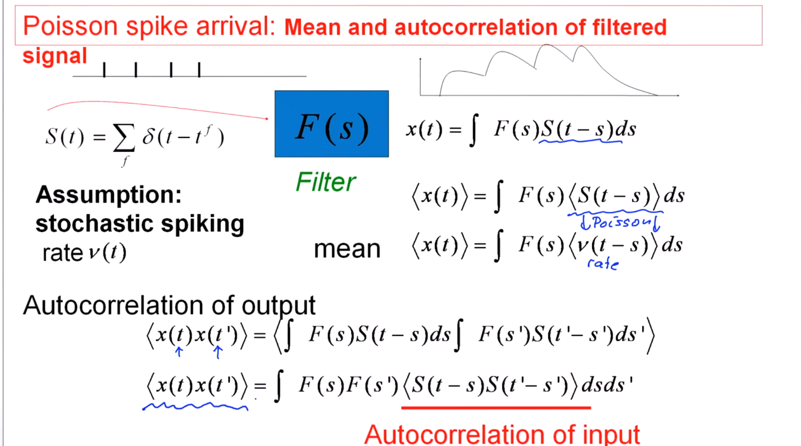

Slide 40
Diffusive noise (stochastic spike arrival)
Stochastic spike arrival:
excitation, total rate Re
inhibition, total rate Ri
Synaptic current pulses
EPSC
IPSC
Blackboard
u
Langevin equation,
Ornstein Uhlenbeck process
Notes:
And a differential equation with a deterministic part plus this white noise input is called the Langevin equation.
The specific linear differential equation with this noisy input is called the Omstein Uhlenbeck process. Now normally in this Omstein Uhlenbeck process we don't have a threshold.

Slide 41
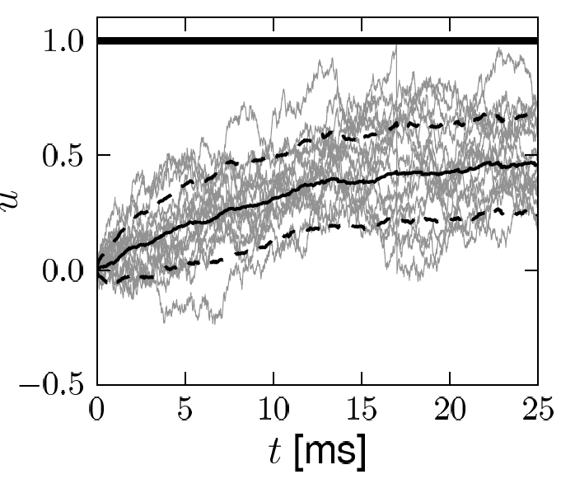
Diffusive noise (stochastic spike arrival)
Math argument:
- no threshold
- trajectory starts at
known value

Slide 42
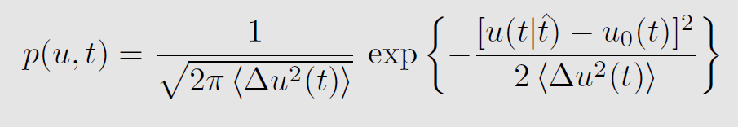
Diffusive noise (stochastic spike arrival)
Math argument
Notes:
And this variance is small at the beginning. In fact, it's 0 at time 0 because all trajectories start at the same value. And then it blows up slightly.
The standard deviation does not increase infinitely. It saturates at some final value.

Slide 43
Neuronal Dynamics – 8.6. Diffusive noise/stoch. arrival
A) No threshold, stationary input
Membrane potential density: Gaussian
u
u
constant input rates
no threshold
p(u)
noisy integration

Slide 44
Neuronal Dynamics – 8.6 Diffusive noise/stoch. arrival
B) No threshold, oscillatory input
Membrane potential density:
Gaussian at time t
u
u
p(u(t))
noisy integration

Slide 45
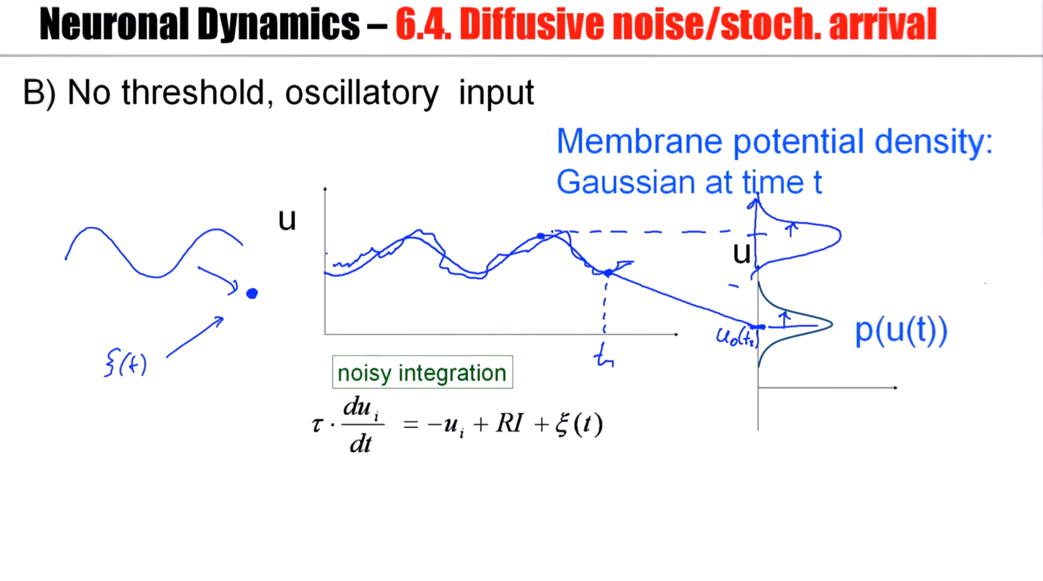

Slide 46
Neuronal Dynamics – 6.4. Diffusive noise/stoch. arrival
C) With threshold, reset/ stationary input
Membrane potential density
u
u
p(u)
Notes:
It cannot be Gaussian. At the threshold, the density for white noise input is always 0.

Slide 47
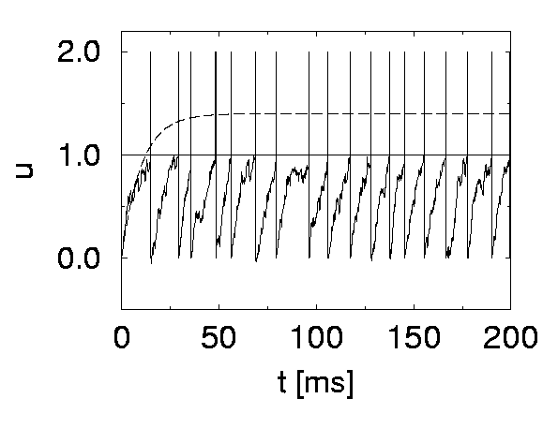
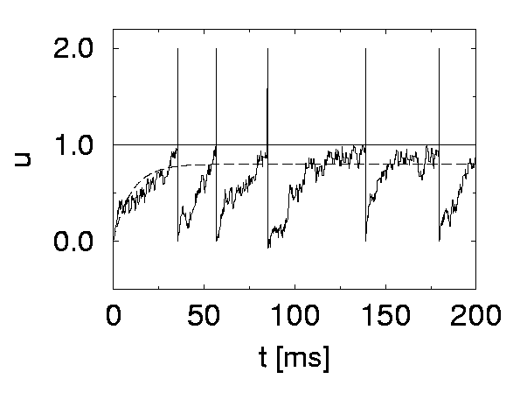
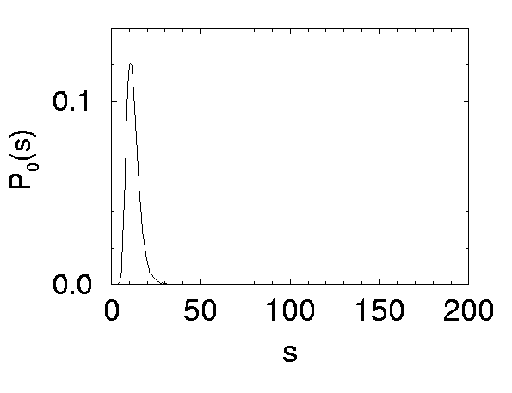
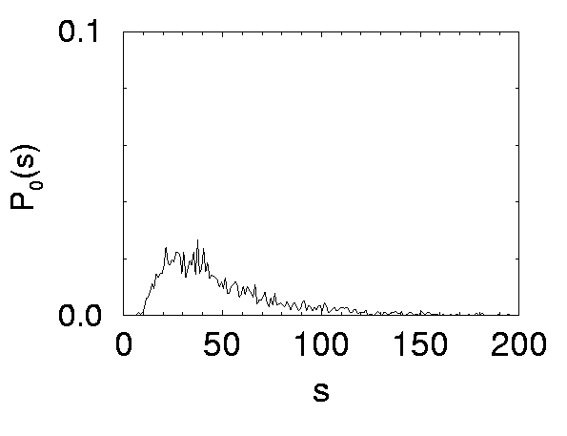
Neuronal Dynamics – 8.6. Diffusive noise/stoch. arrival
Superthreshold vs. Subthreshold regime
u
p(u)
p(u)
Nearly Gaussian
subthreshold distr.
Image:
Gerstner et al. (2013)
Cambridge Univ. Press;
See: Konig et al. (1996)
Notes:
non-Gaussian vs trimmed Gaussian

Slide 48
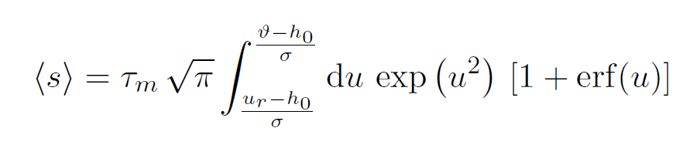
Neuronal Dynamics – 8.6. Comparison of Noise Models
escape process
(fast noise)
stochastic spike arrival
(diffusive noise)
A
C
u(t)
t
Stationary input:
Mean ISI
Mean firing rate
escape rate
noisy integration
Interval distribution
noise
Siegert 1951
white
(fast noise)
synapse
(slow noise)
: first passage
time problem
escape
rate
(Brunel et al., 2001)
Survivor function
Notes:
And the mean firing rate is just 1 over the mean interval.

Slide 49
Neuronal Dynamics – 8.6 Comparison of Noise Models
Diffusive noise
- distribution of potential
- mean interspike interval
FOR CONSTANT INPUT
- time dependent-case difficult
Escape noise
- time-dependent interval
distribution
Notes:
For diffusive noise, we are able to calculate the distribution of membrane potential. We are able to calculate the mean inter-spike interval for constant input, but the time-dependent case is difficult.
The advantage of an escape noise formulation is that we have access to the time-dependent interval distribution.
Now the question arises whether the diffusive noise model can be approximated by an escape noise model.

Slide 50
Noise models: from diffusive noise to escape rates
noisy integration
stochastic spike arrival
(diffusive noise)
escape rate

Slide 51
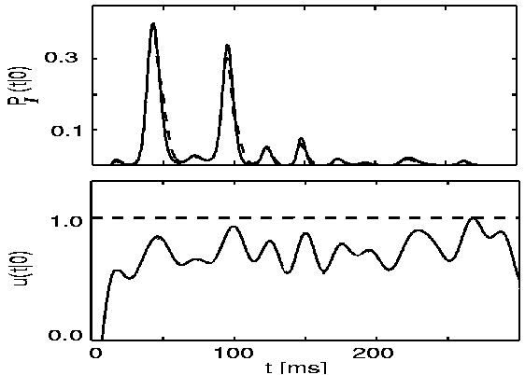
Comparison: diffusive noise vs. escape rates
Plesser and Gerstner (2000)
Probability of first spike
diffusive
escape
subthreshold
potential
escape rate

Slide 52
Neuronal Dynamics – 8.6 Comparison of Noise Models
Diffusive noise
- represents stochastic spike arrival
- easy to simulate
- hard to calculate
Escape noise
- represents internal noise
- easy to simulate
- easy to calculate
- approximates diffusive noise
- basis of modern model fitting methods

Slide 53
Neuronal Dynamics – Quiz 8.4.
A. Consider a leaky integrate-and-fire model with diffusive noise:
[ ] The membrane potential distribution is always Gaussian.
[ ] The membrane potential distribution is Gaussian for any time-dependent input.
[ ] The membrane potential distribution is approximately Gaussian for any time-dependent input,
as long as the mean trajectory stays ‘far’ away from the firing threshold.
[ ] The membrane potential distribution is Gaussian for stationary input in the absence of a threshold.
[ ] The membrane potential distribution is always Gaussian for constant input and fixed noise level.
B. Consider a leaky integrate-and-fire model with diffusive noise for time-dependent input. The above figure
(taken from an earlier slide) shows that
[ ] The interspike interval distribution is maximal where the determinstic reference trajectory is closest to the threshold.
[ ] The interspike interval vanishes for very long intervals if the determinstic reference trajectory
has stayed close to the threshold before - even if for long intervals it is very close to the threshold
[ ] If there are several peaks in the interspike interval distribution, peak n is always of smaller amplitude than peak n-1.
[ ] I would have ticked the same boxes (in the list of three options above)
for a leaky integrate-and-fire model with escape noise.

Slide 54
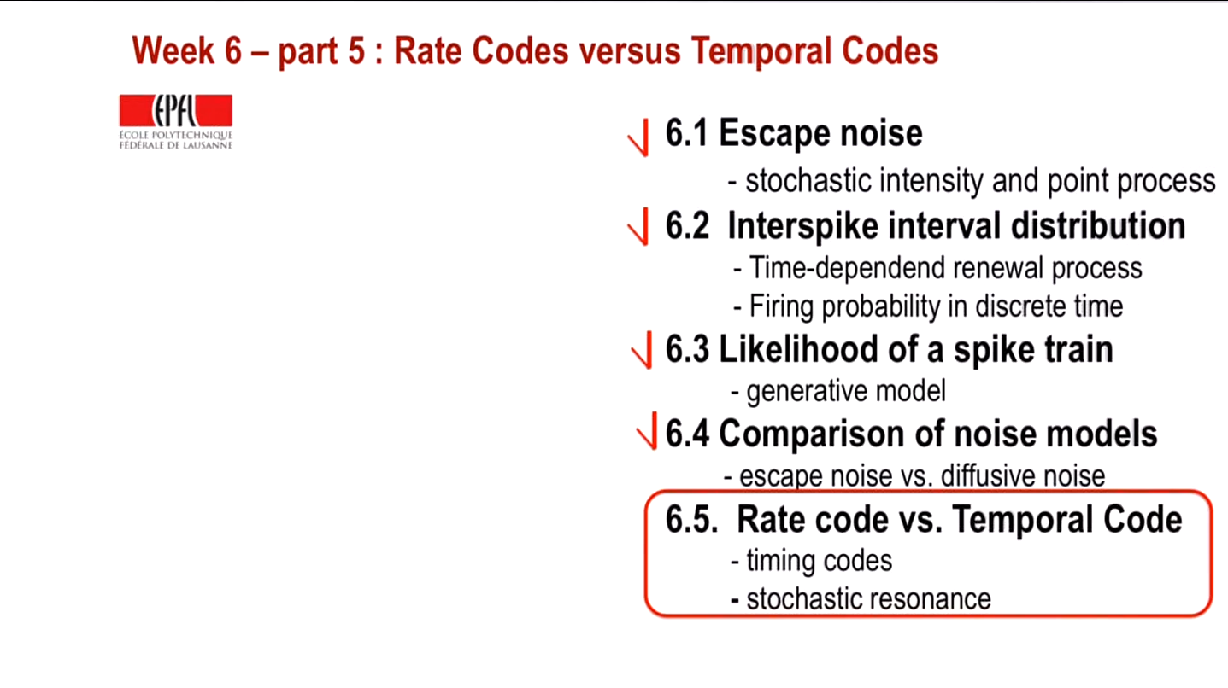

Slide 55
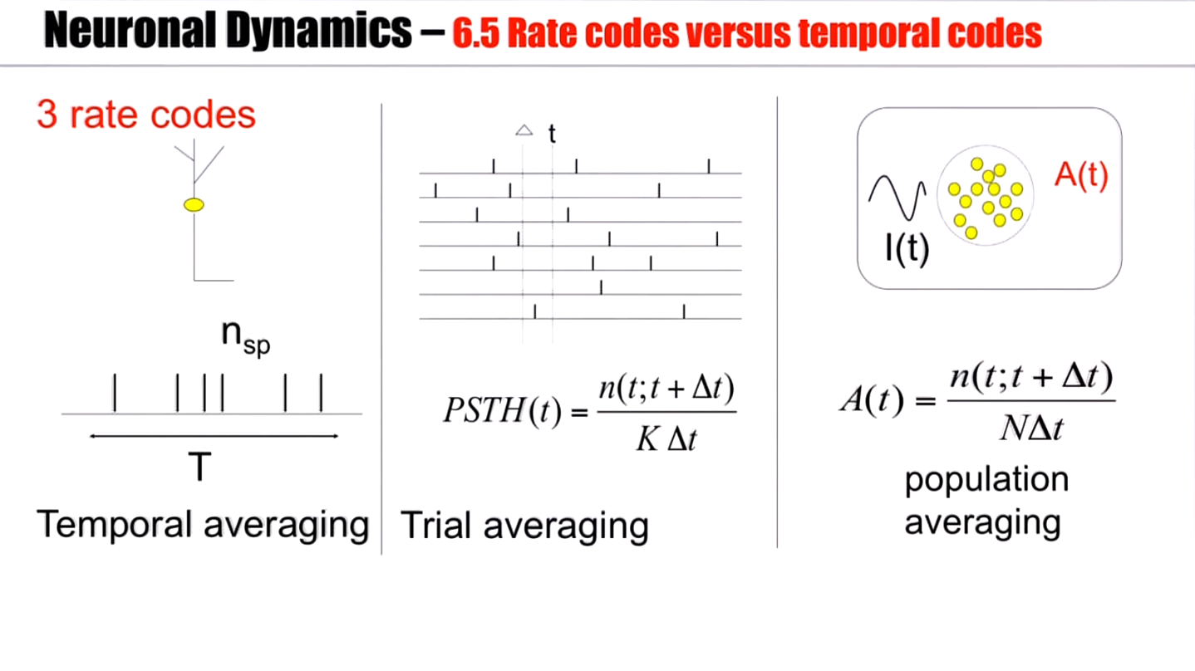

Slide 56
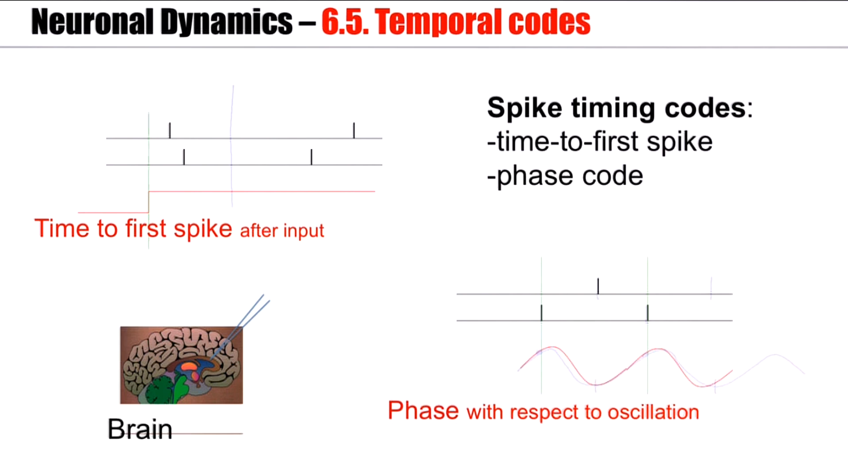
Notes:
Rate codes however are not the only coding principles.
A related concept is that of phase coding. In fact, in some areas of the brain there's always some ongoing oscillation, which you would see in the EEG in global measurements of brain activity.
比如右下的图，一个神经元总是在振荡的最高点之前spike，另一个神经元总是在振荡的最低点左右spike

Slide 57
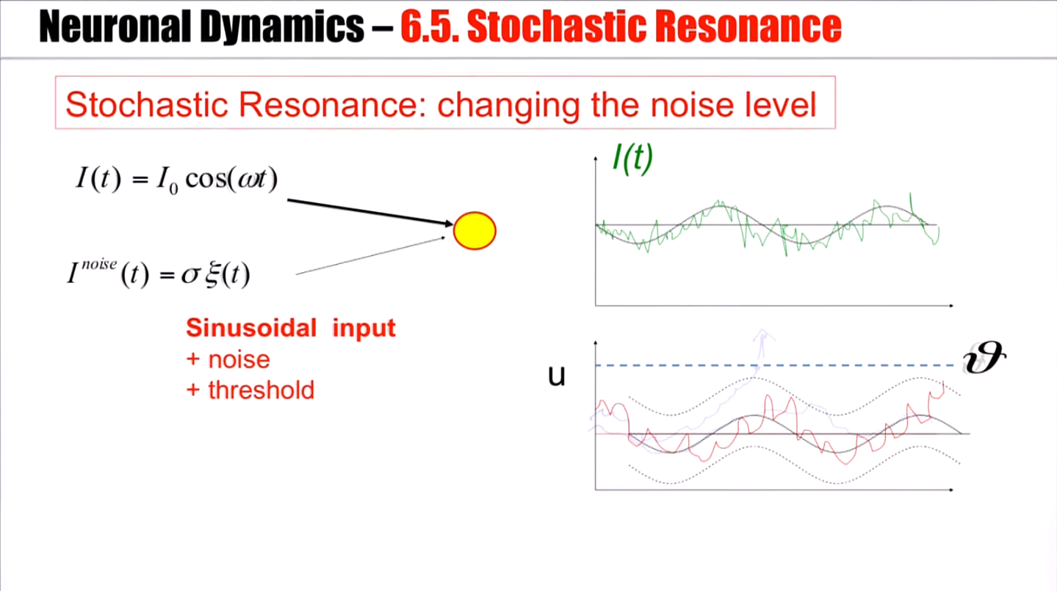

Slide 58
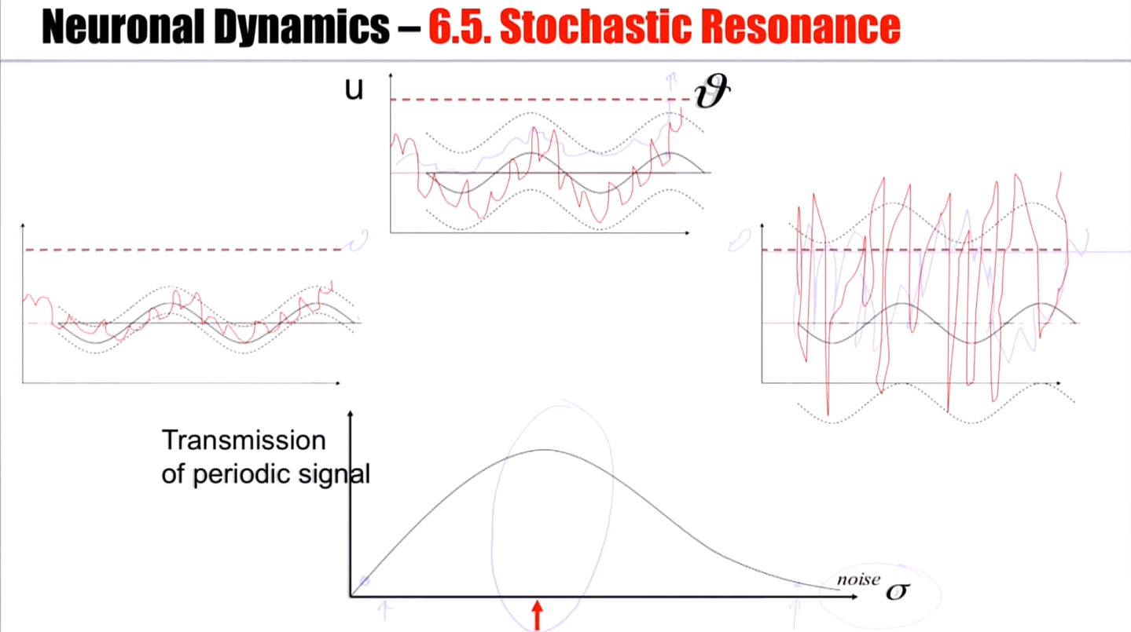
Notes:
如果噪音很大，盖过了信号，那么spike基本上可以在任何地方发生，找不到规律，你无法看到潜在的神经振荡。
如果噪音又太小了，又基本上无法spike，也看不到任何规律。
So there's this optimal noise level for signal transmission. And in fact, it's called stochastic resonance.

Slide 59
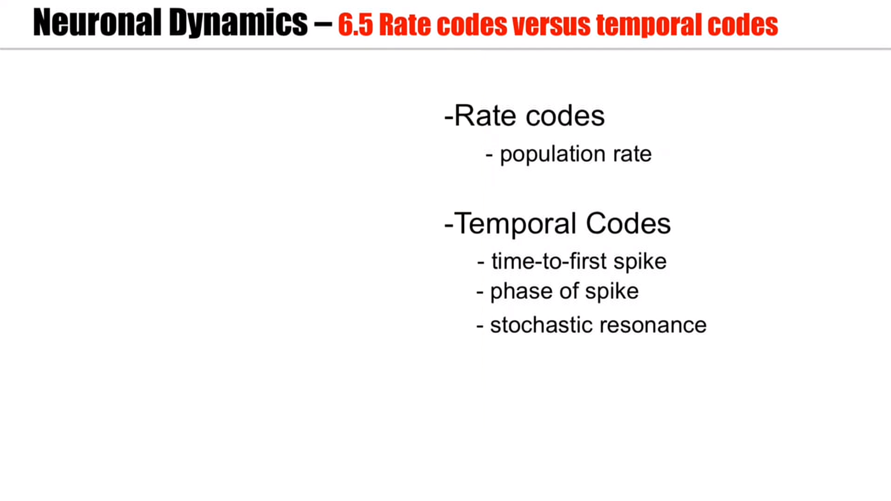

Slide 60
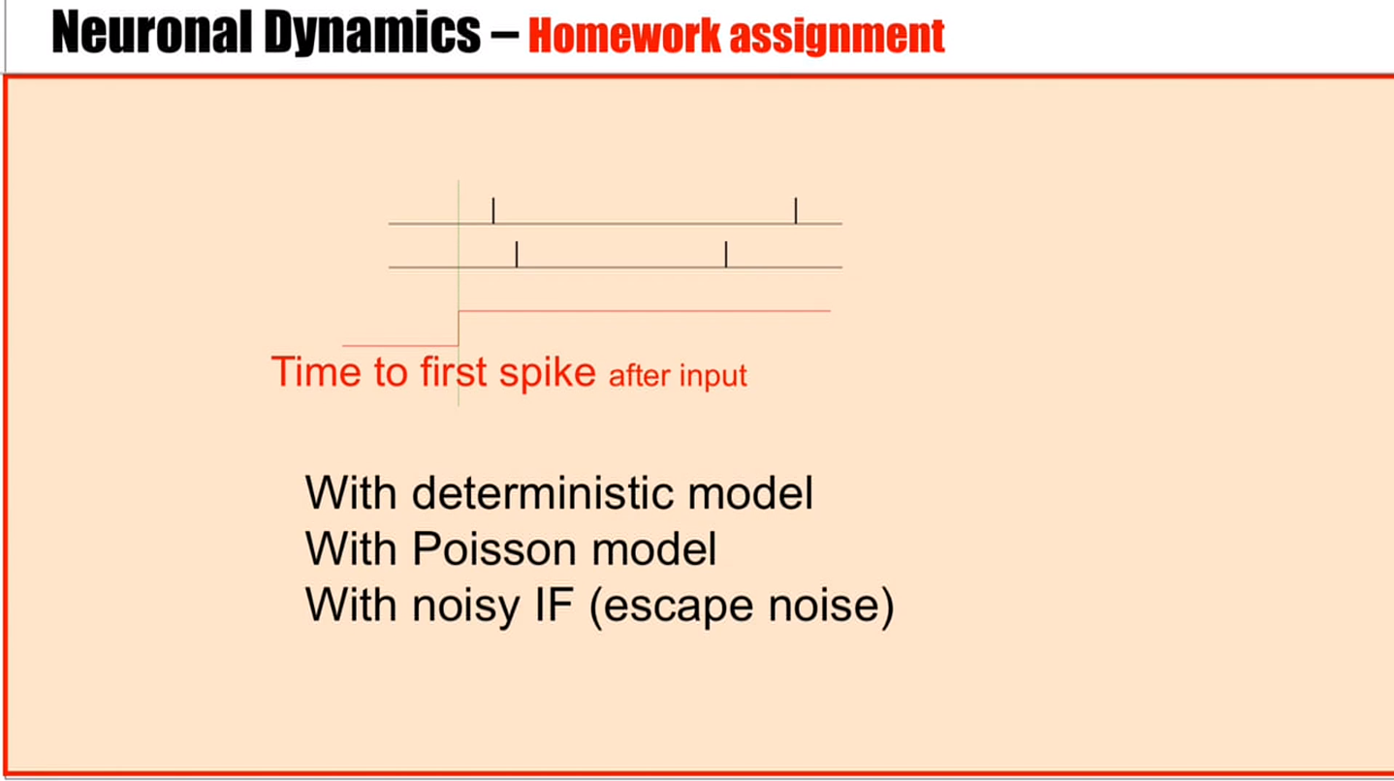

Slide 61
